Slide 1

MIXED SIGNAL PCB DESIGN FOR DATA CONVERTERS
Andrew Slater

Slide 2
Background
Multi-layered mixed signal design.
Crosstalk between analogue and digital signals.
Differing ground plane recommendations.
Separation of analogue and digital signals.
Aggressor
Victim

Slide 3
Motivation and Aims
Lack of quantitative evidence towards the effectiveness of split and continuous ground plane crosstalk performance.
Aim: Build two identical bespoke PCBs to use as research boards.
Split ground plane design.
Non-split ground plane design.

Slide 4
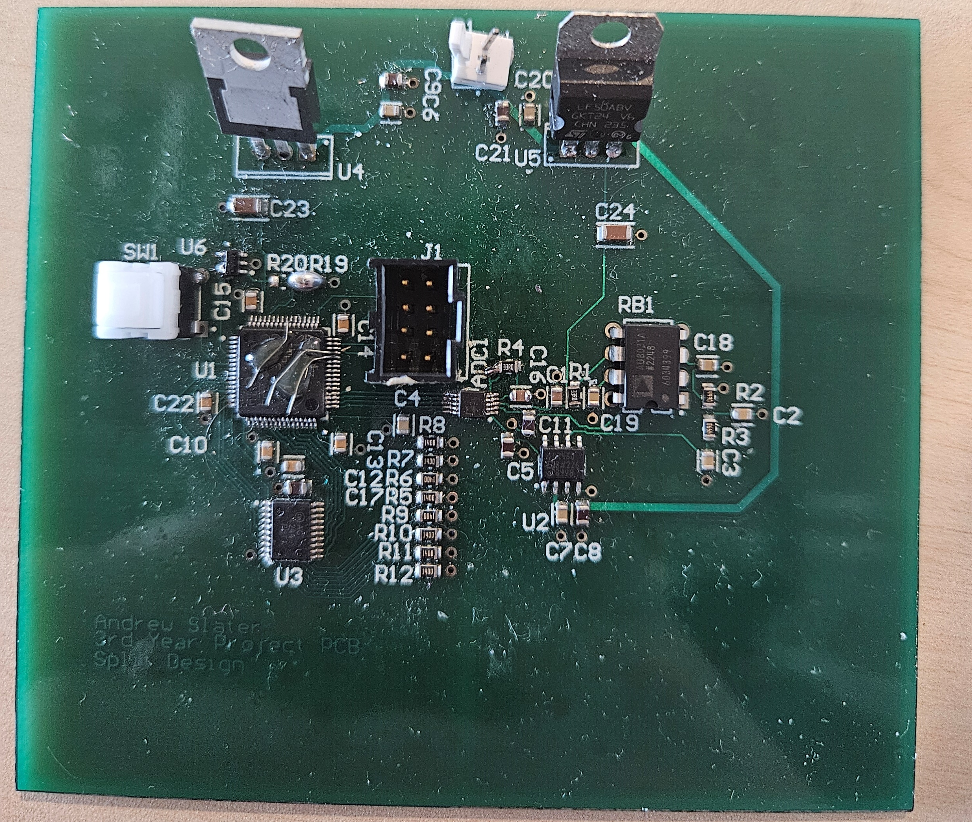
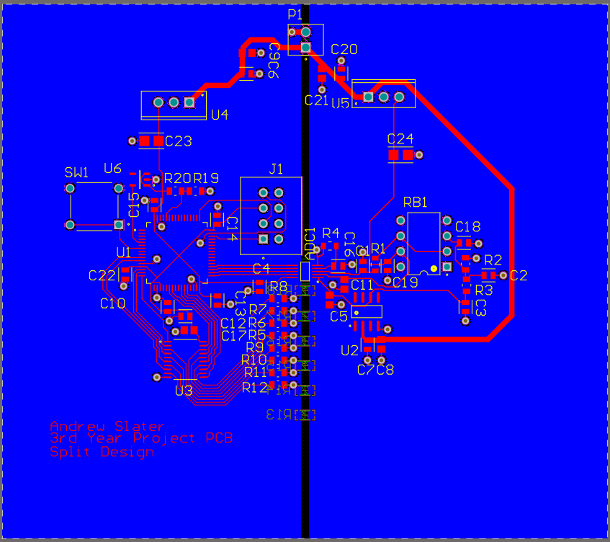
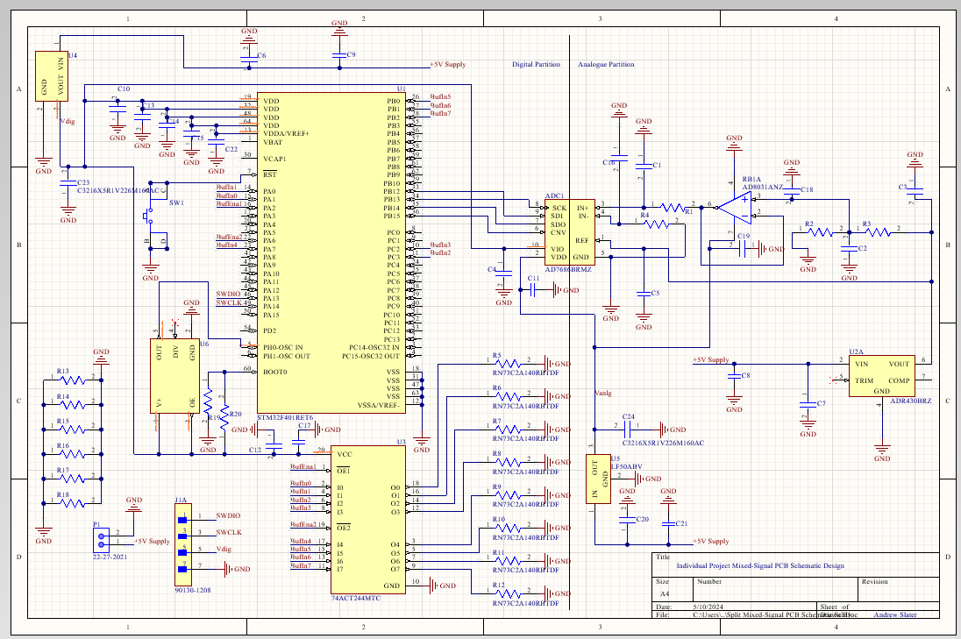
Basic Methodology:
PCB Schematic
PCB Layout
Manufactured PCB

Slide 5
PCB Development:
Digital Partition
Analogue Partition

Slide 6
PCB Development:
Digital Partition
Analogue Partition

Slide 7

PCB Development:
Digital Partition
Analogue Partition

Slide 8
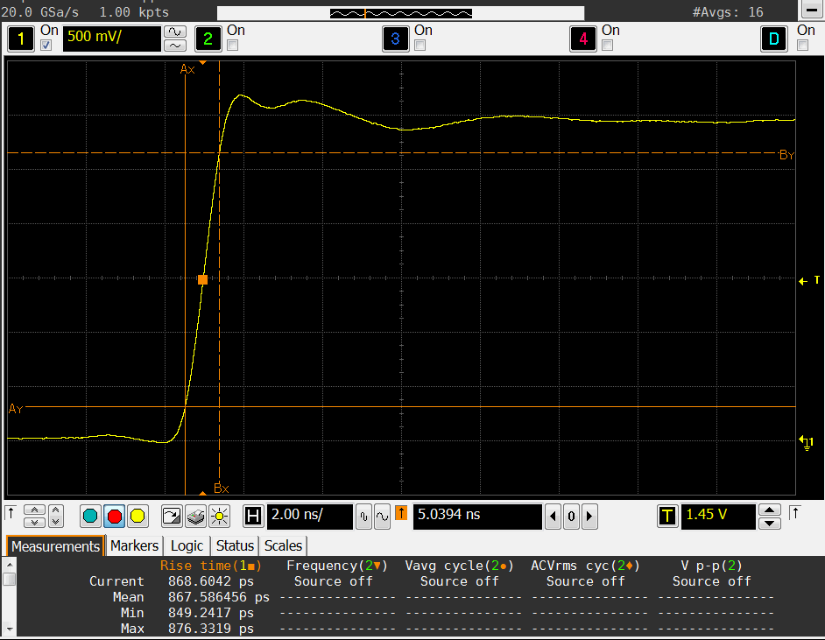
Results:
Single Pin Disturbance:
Minimum Rise Time: 0.753 ns
Measured Rise Time: 0.868 ns
Transmission Lines are capable of causing significant disturbance.

Slide 9
Results:
Sample Sets:
Sample Set: | Undisturbed Signal Non-Split PCB | Disturbed Signal Non-Split PCB | Undisturbed Signal Split PCB | Disturbed Signal Split PCB
Average | 32703.3 | 32701.3 | 32781.4 | 32780.3
2 code difference in output.
DC restricted in the ground plane.

Slide 10
Results:
Pulse and Step Signals:

Slide 11
Conclusions:
PCBs were capable at providing exact equal control.
The project proves it is viable to test the difference between ground plane configurations even if some results were inconclusive.
Improvements could be made to the PCBs such as increased layer count, a faster microcontroller, multiple microcontrollers, etc.

